Slide 1

Multilabel and Multiclass Analysis of Social Determinants of Health
Rufino Salgado 2020

Slide 2
The Project
Analyzing patient information to determine what could be utilized to predict future encounters with healthcare.

Slide 3
Goals:
Interpret patient data.
Demographic information - Age, Income levels, etc.
Medical history - Number of visits, time spent with physician, etc.
Train on predictive models
Predict multiple potential barriers to treatment
Lack of transportation, language barriers, financial burdens
Predict multiple potential actions to take
Appointment reminders, interpreters, referrals
Predict the intensity of visit counts
The rate of visits
Analyze results
Determine methods of improving future data collection to improve performance of these models.

Slide 4
Data
DuPage County and Chinatown neighborhood patients
Collected at different times.
Provided by Northwestern researchers and healthcare providers
Two datasets of DuPage patient records
Medical visit data – 435 patients
Patient demographic data -483 patients
400 complete sets
Two datasets of Chinatown patients records
Medical visit data - 331 patients
Patient demographic data – 275 patients
274 complete sets
674 complete sets of patient data from all sources

Slide 5
Preprocessing
Challenges
Multiple datasets
Imbalanced data
Missing information
Incomplete sets
Missing values
Different formatting
Mismatched value categories
Income levels
Employment
Foreign language data
Different data collected
Lack of common features
Lack of information about the information
No means to match data

Slide 6
Preprocessing (continued)
Four features
Age, primary language, country of birth, and zipcode
Classifications done with just these features resulted in performance around 20 to 30 percent
More information was requested
Expanded codebook
Additional data for previous patients
Feature extraction
Visit count
Distance to Hospital, Estimated Driving Time, Estimated Travel Time on Public Transportation
New list of features
Age, primary languages, birth country, marital status, education levels, household sizes, income levels, employment statuses, visit counts and the distance features including distance in km, driving time, and transit time if available.

Slide 7
Barriers
Coded
L1 - Illiterate, L2 – Unfamiliar with Medical Terms etc.
Most prevalent classes
‘None’ – No barrier encountered
‘LI1’ – Uncomfortable speaking English
‘CM’ – Case management issues
‘F1’ – Fear of unknown diagnosis/test results

Slide 8
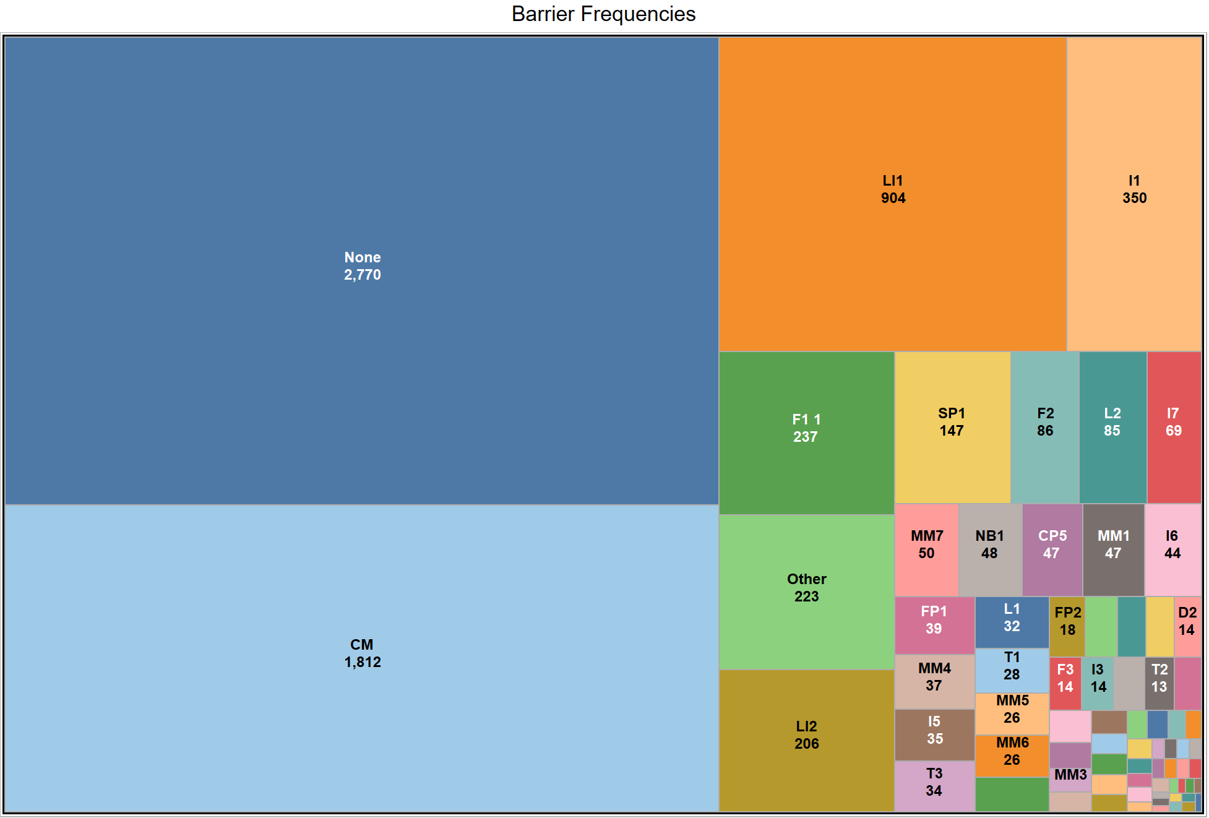

Slide 9
Analysis
3 most frequent barriers per patient
Multilabel classification
Keras API
9 layers
One dimensional convolutional layer
Max pooling layer
Flattening layer
Series of Dropout and Dense layers
Repeated K-Fold Cross Validation

Slide 10
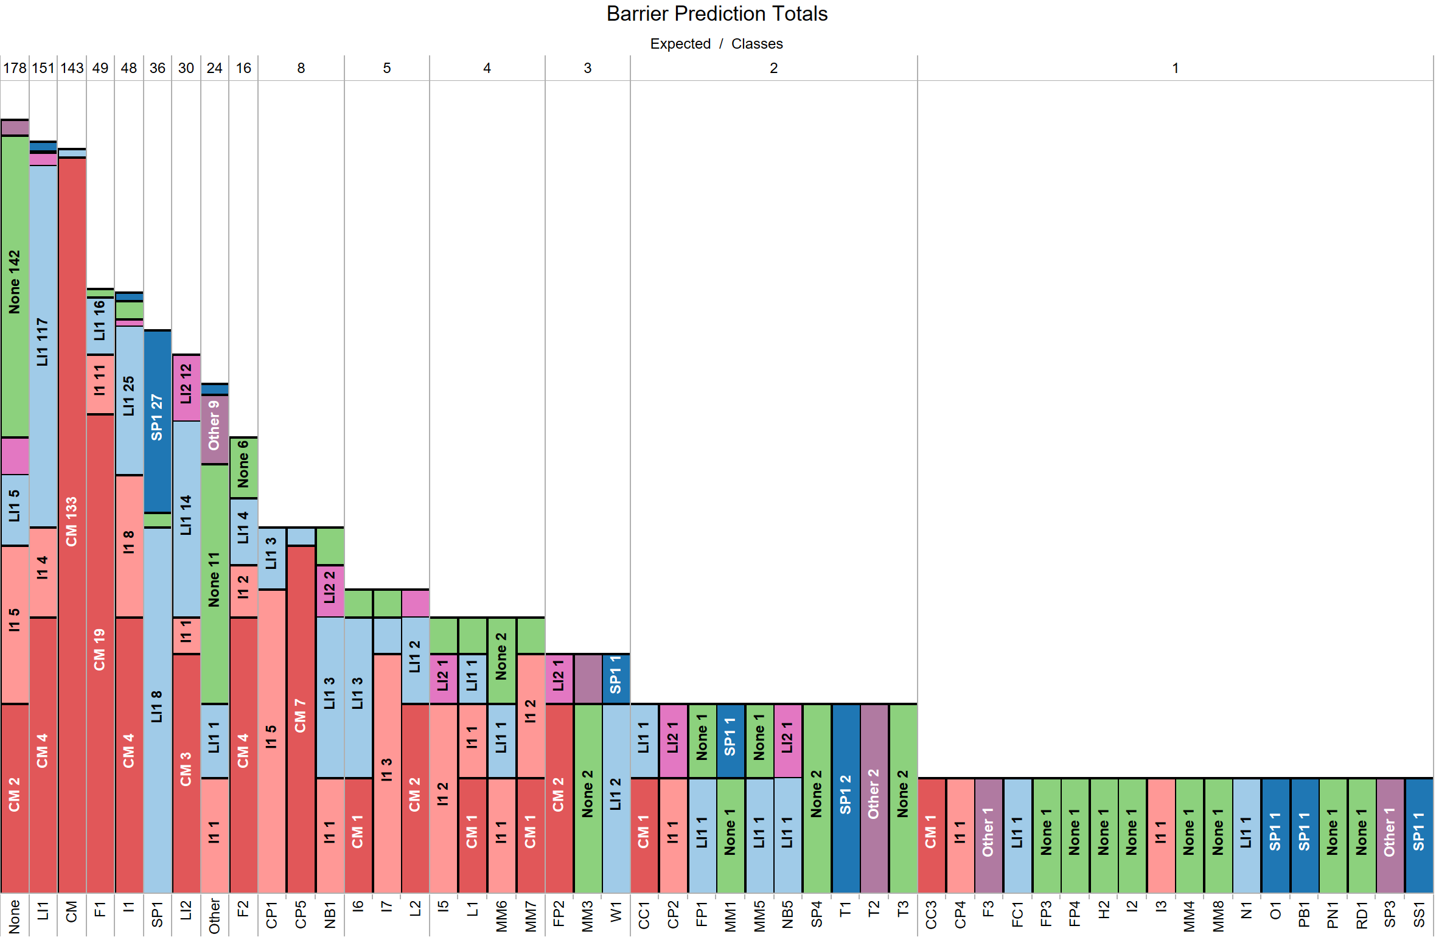

Slide 11
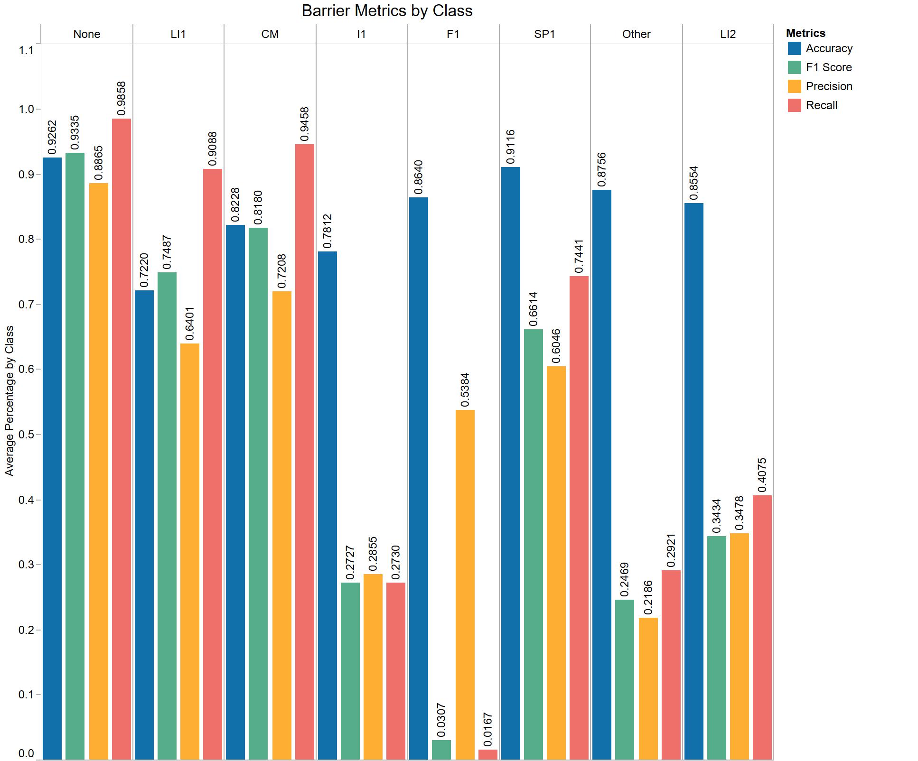

Slide 12
Actions
Most prevalent classes
‘AC1’ – Accompaniment to health service
‘RD1’ – Call patient
‘Other’ – Action taken not listed
‘None’ – No action taken
‘SA1’ – Schedule/Reschedule appointment

Slide 13
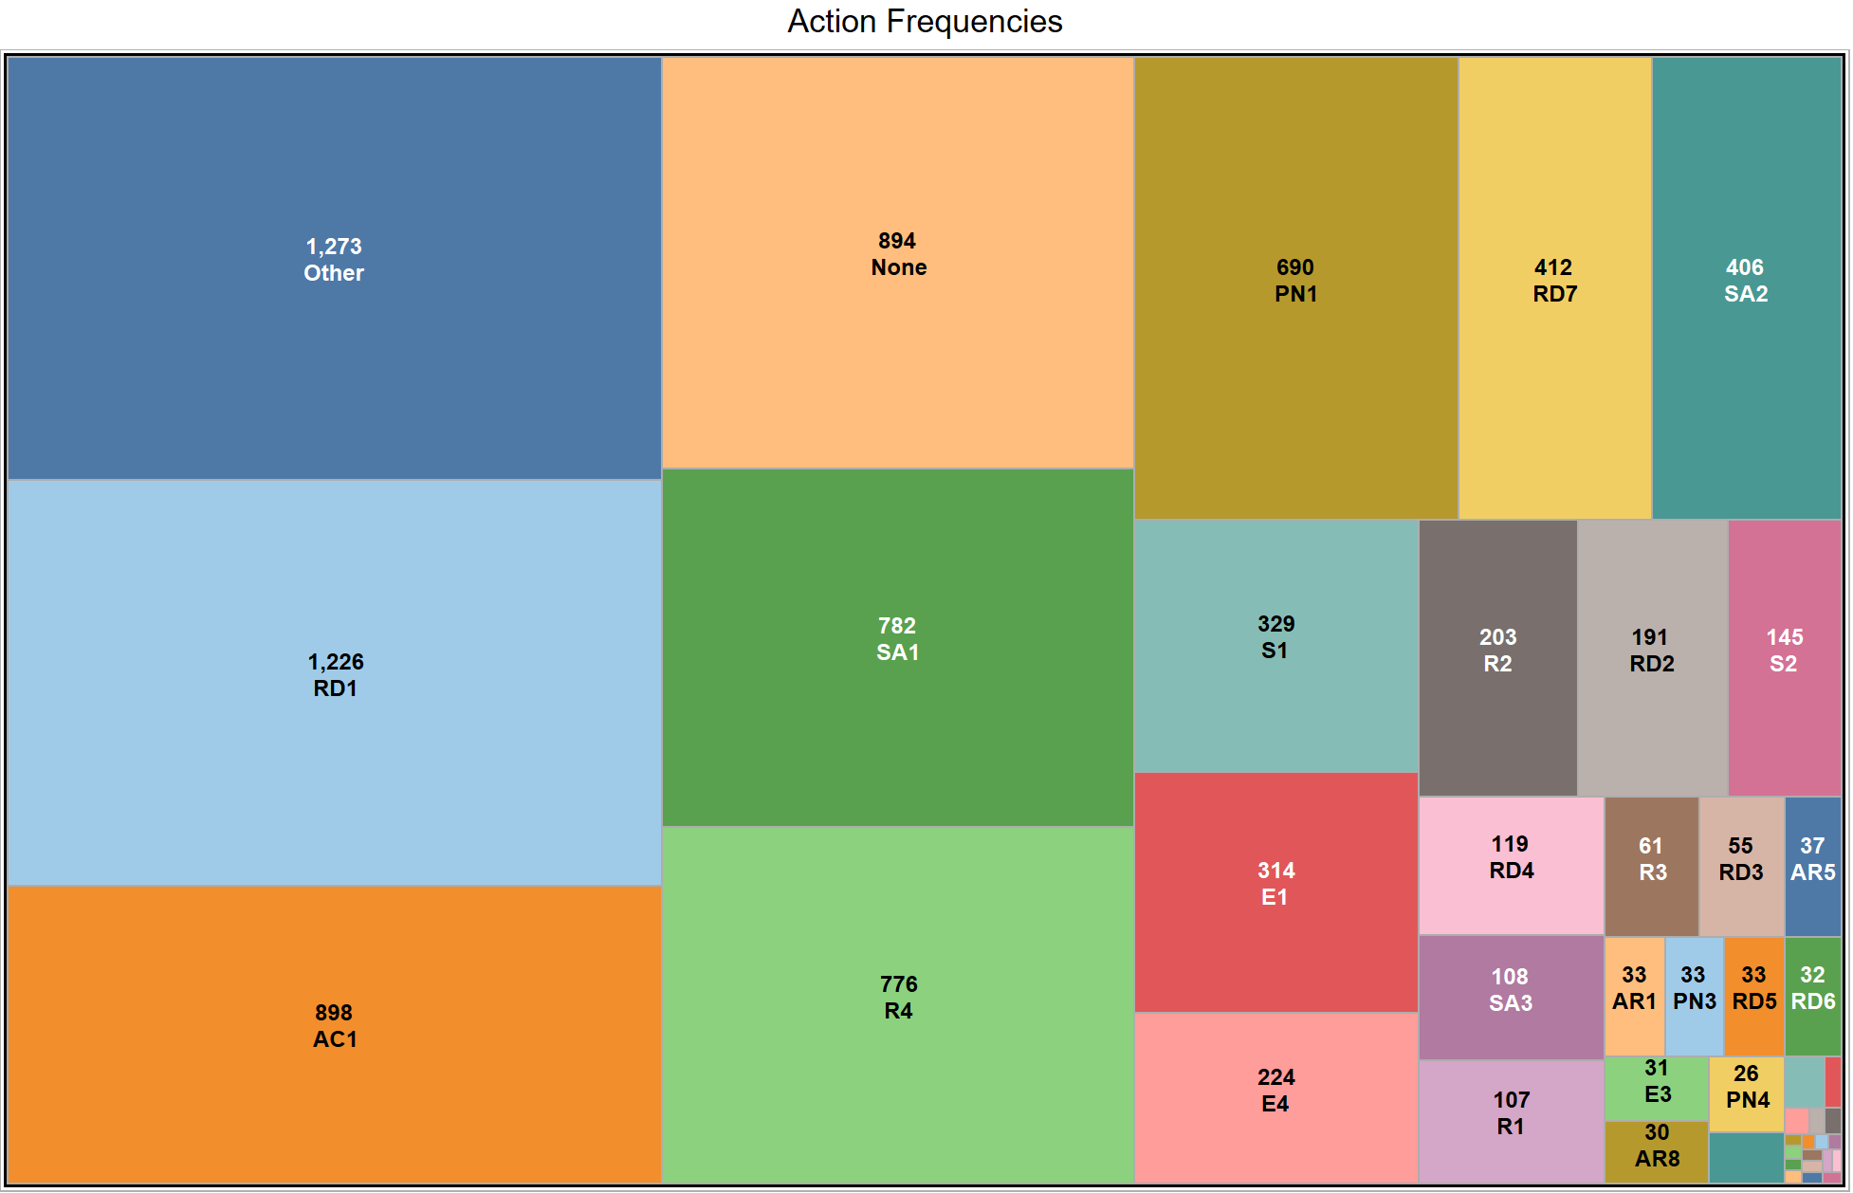

Slide 14
Analysis
3 most frequent actions taken for patients
Multilabel classification
Keras API
9 layers
One dimensional convolutional layer
Max pooling layer
Flattening layer
Series of Dropout and Dense layers
Repeated K-Fold Cross Validation

Slide 15
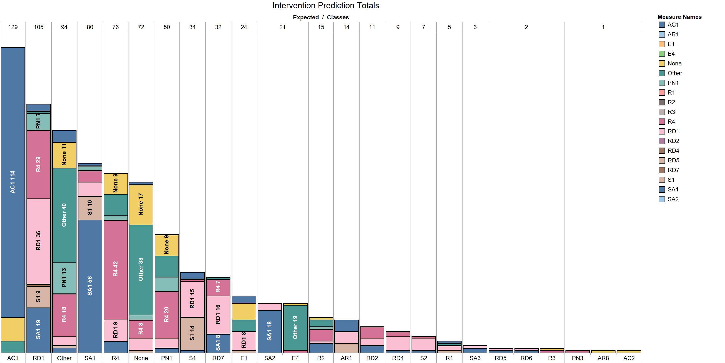

Slide 16
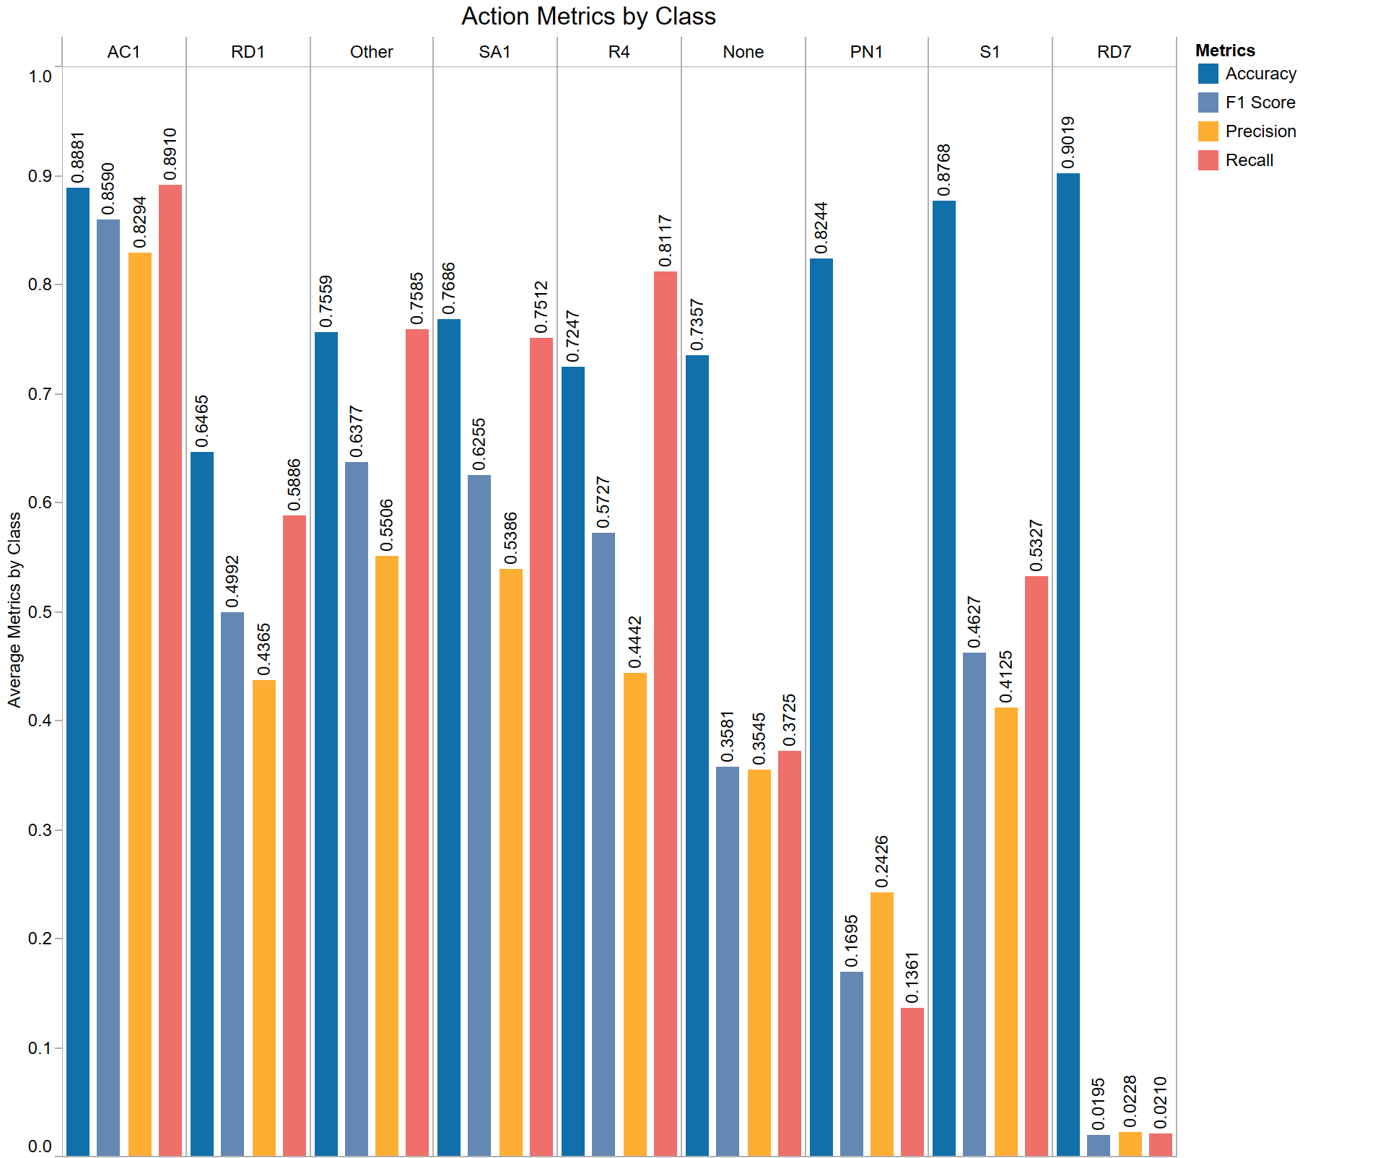

Slide 17
Visit Intensity
New request for visit predictions
Visits counts were sorted into ranges
One class per patient
Low, Medium, High, and Very High
Each range determined by standard deviations from the mean.
Multiclass classification
Support Vector Machine Algorithm
Tested multiple algorithms
LinearSVC, Polynomial function SVC, RBF function SVC

Slide 18
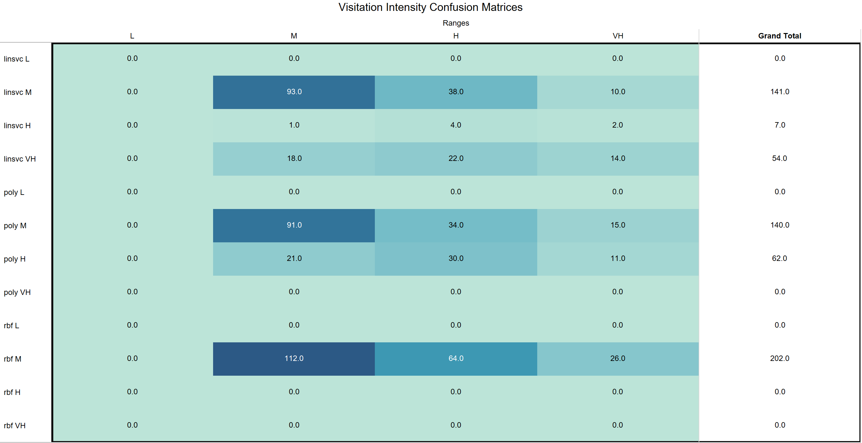

Slide 19
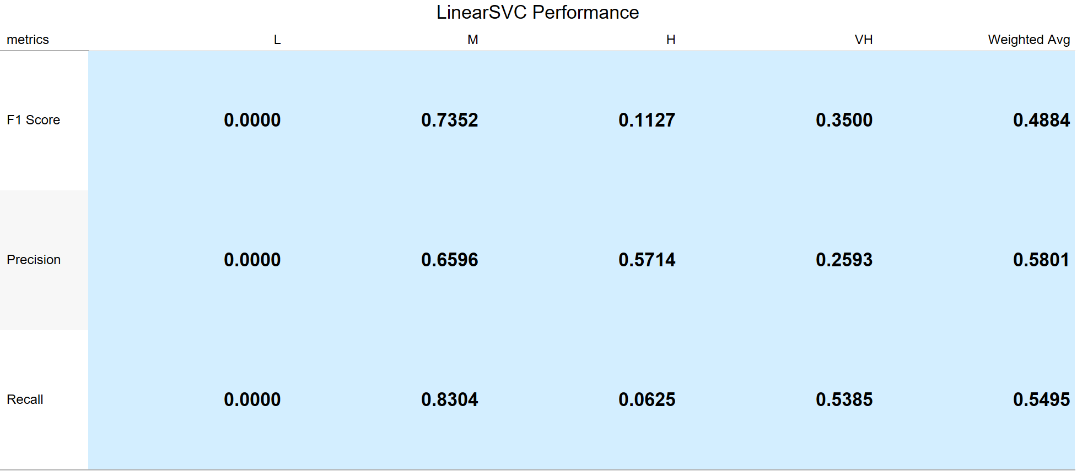

Slide 20
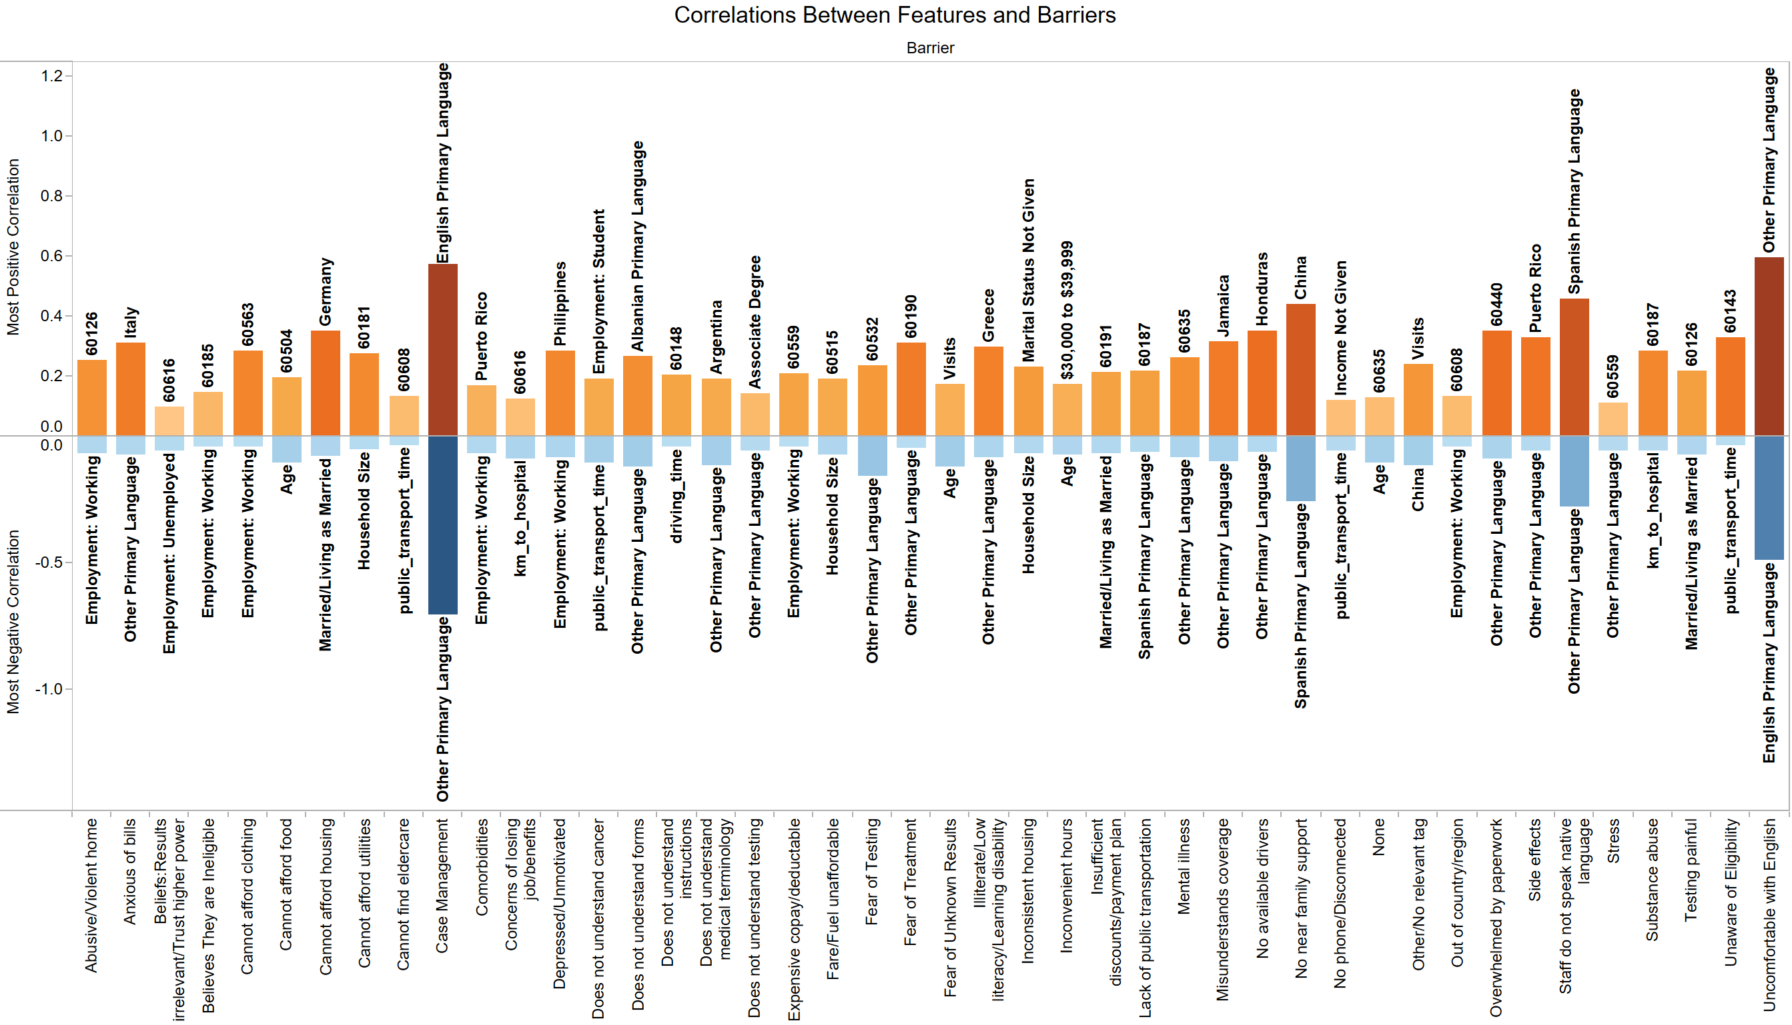

Slide 21
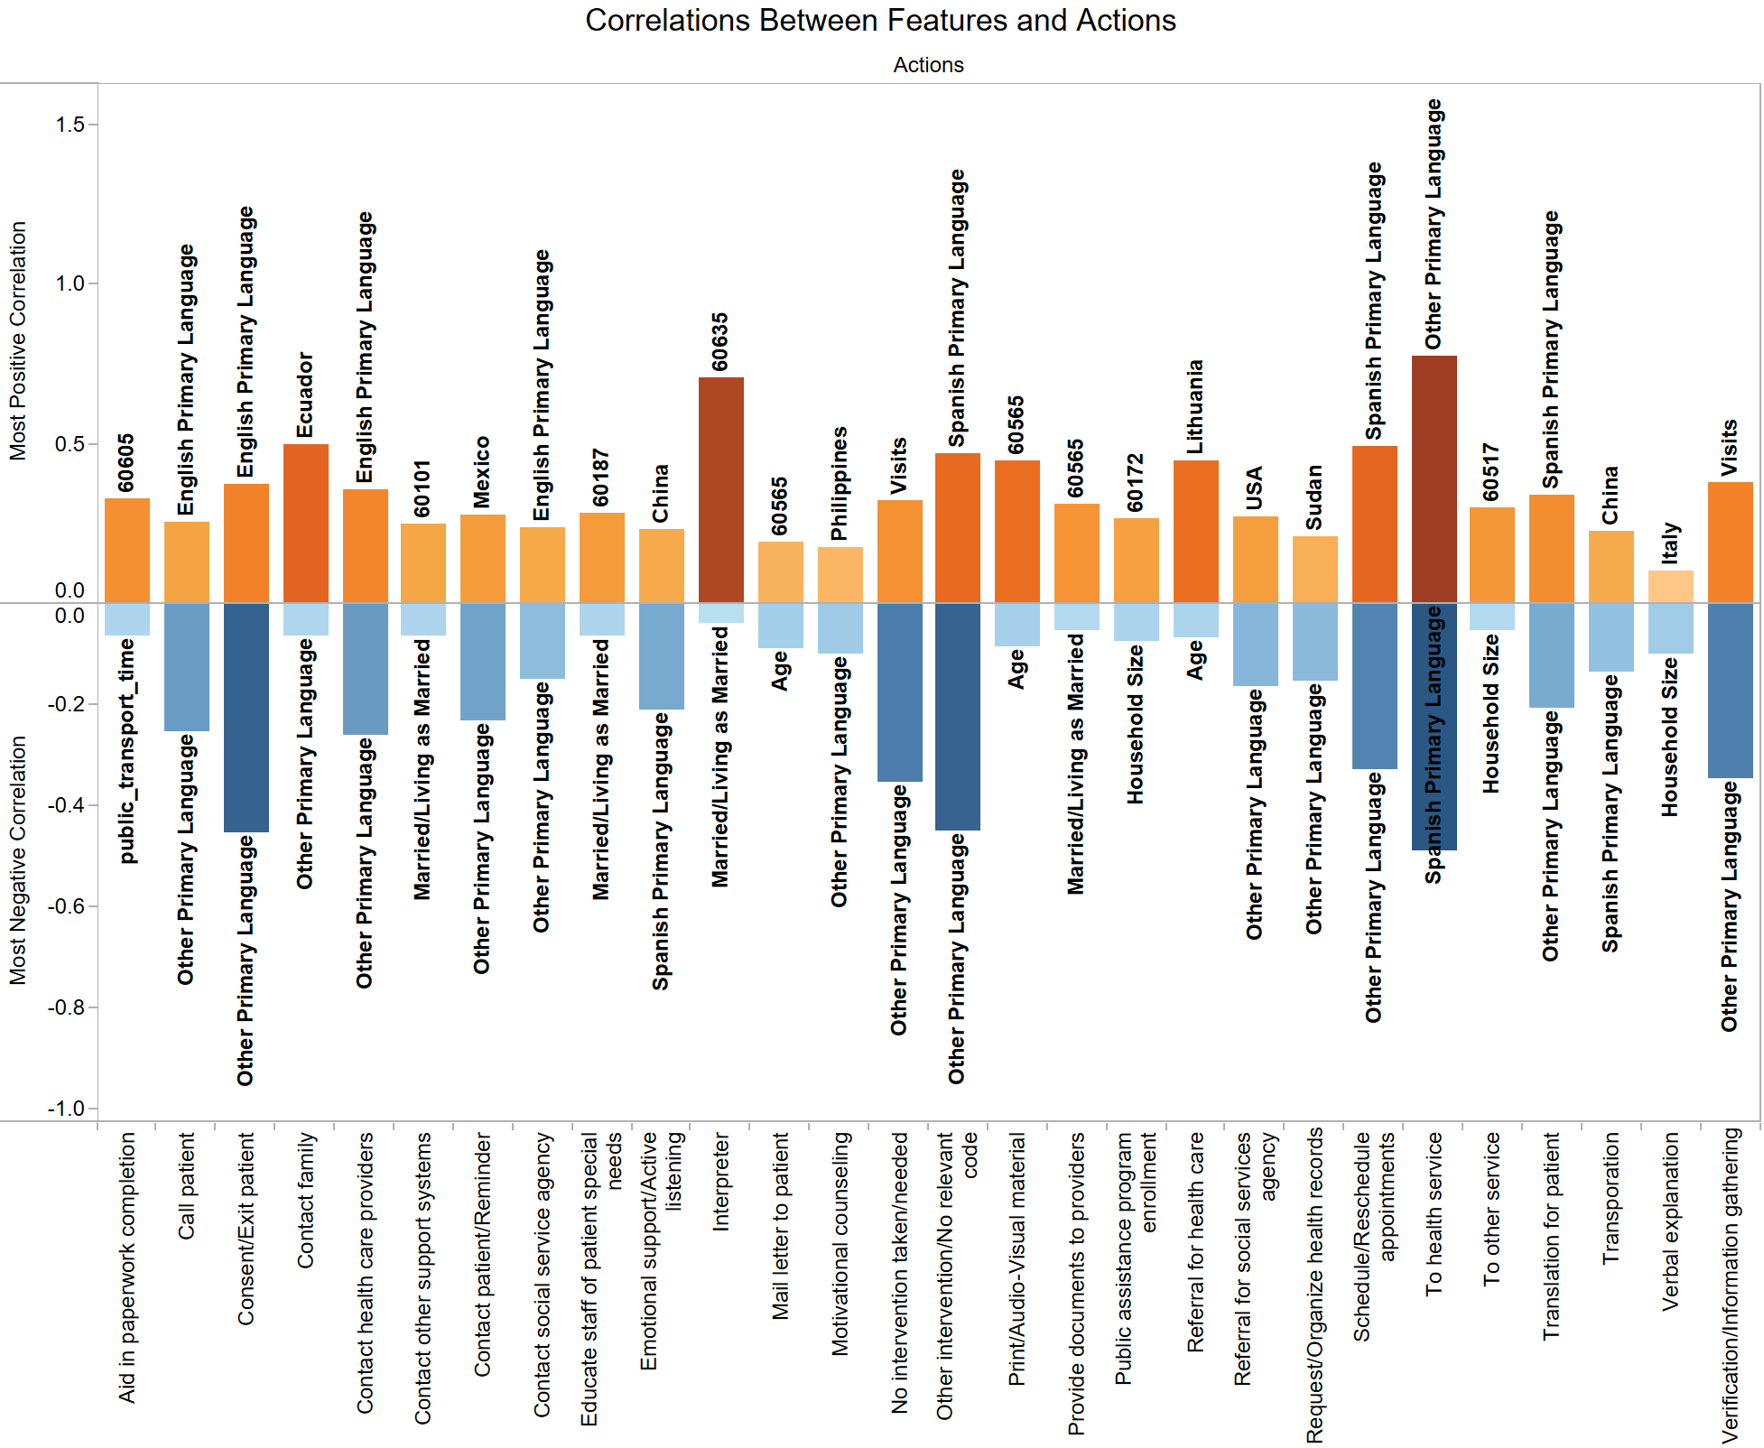

Slide 22
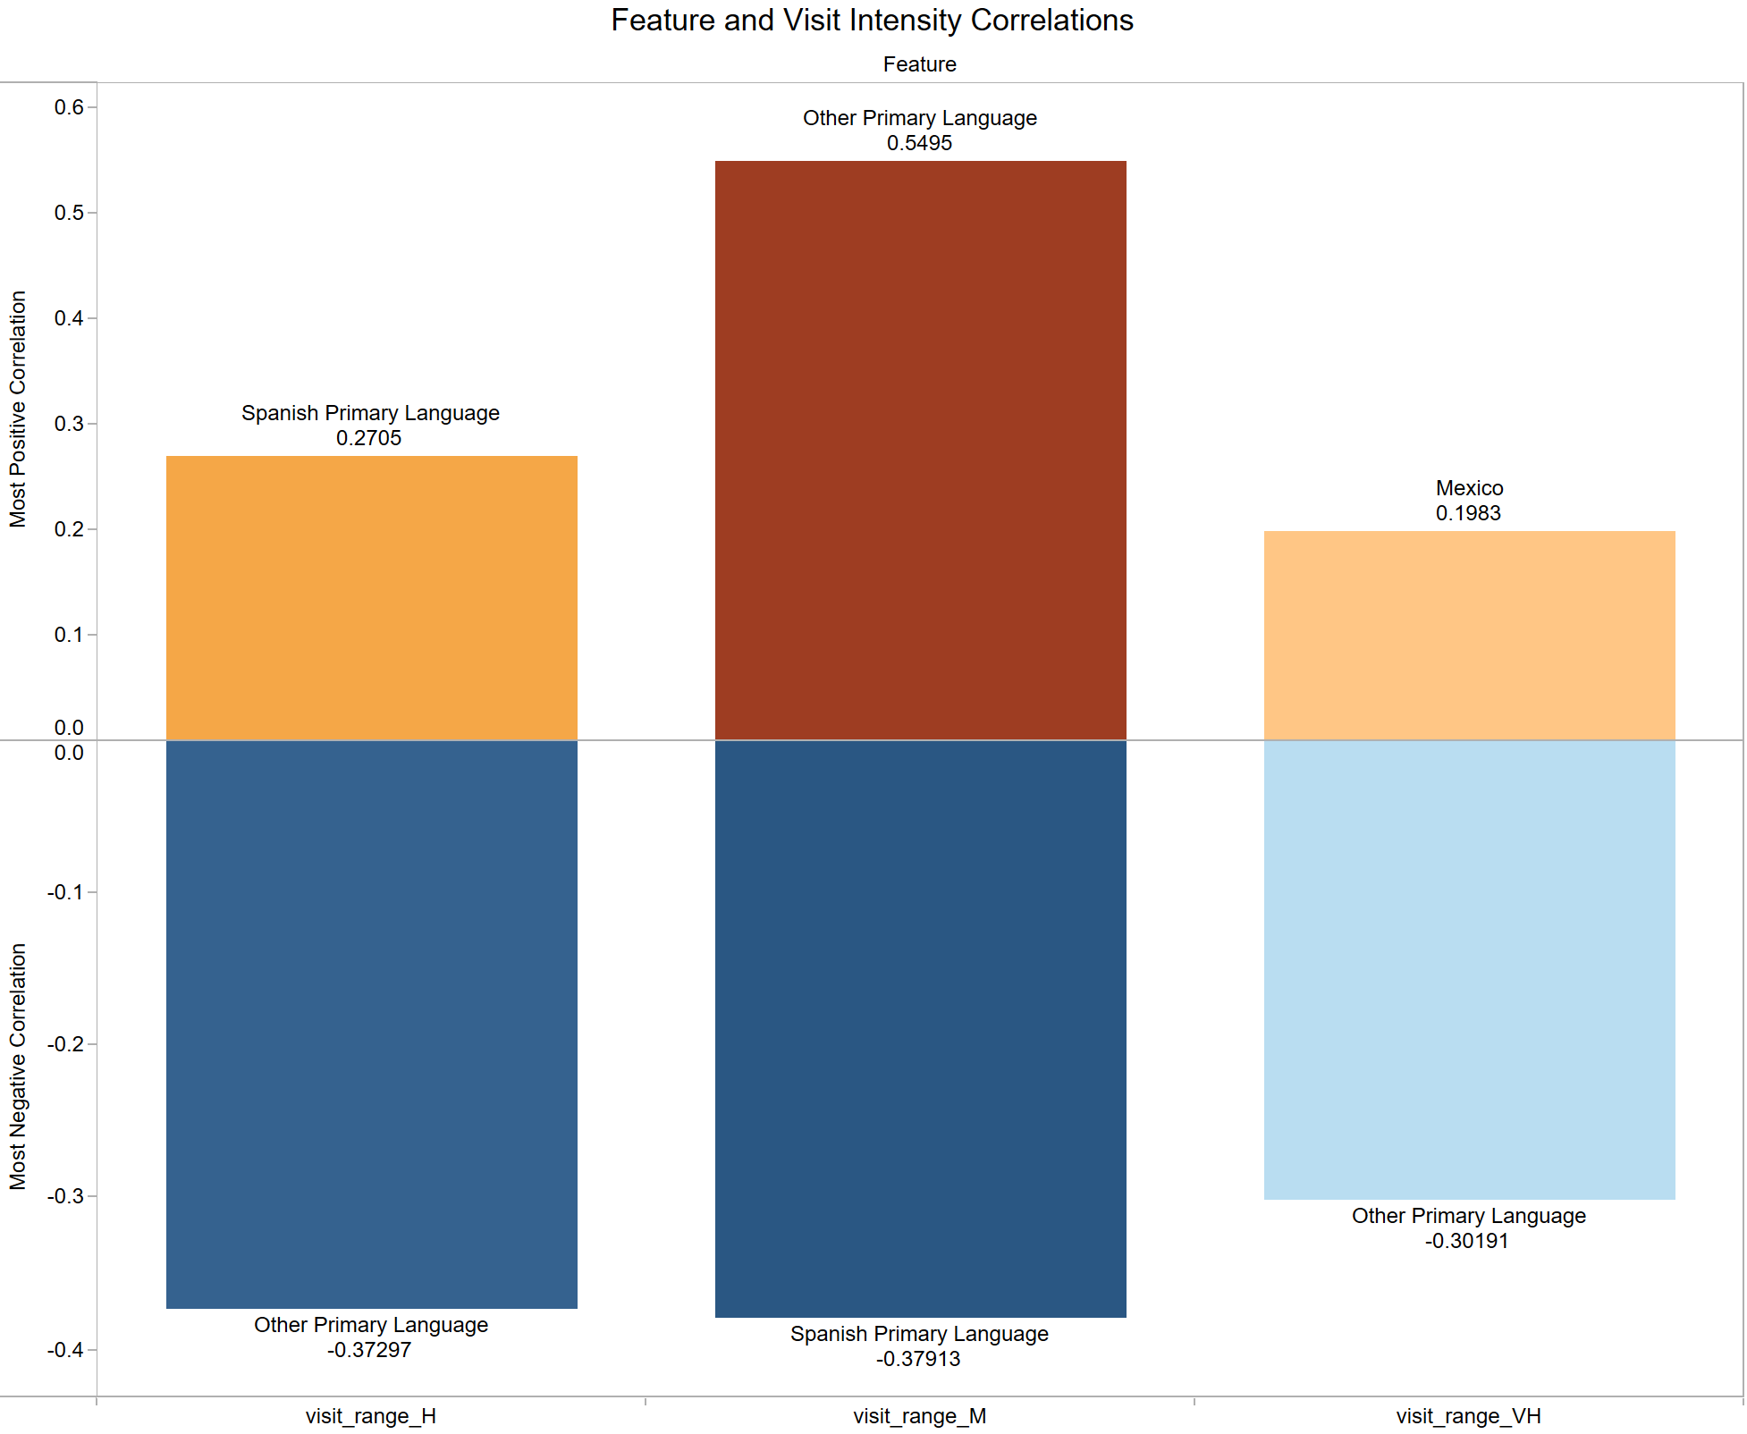

Slide 23
Thank You!

Slide 24
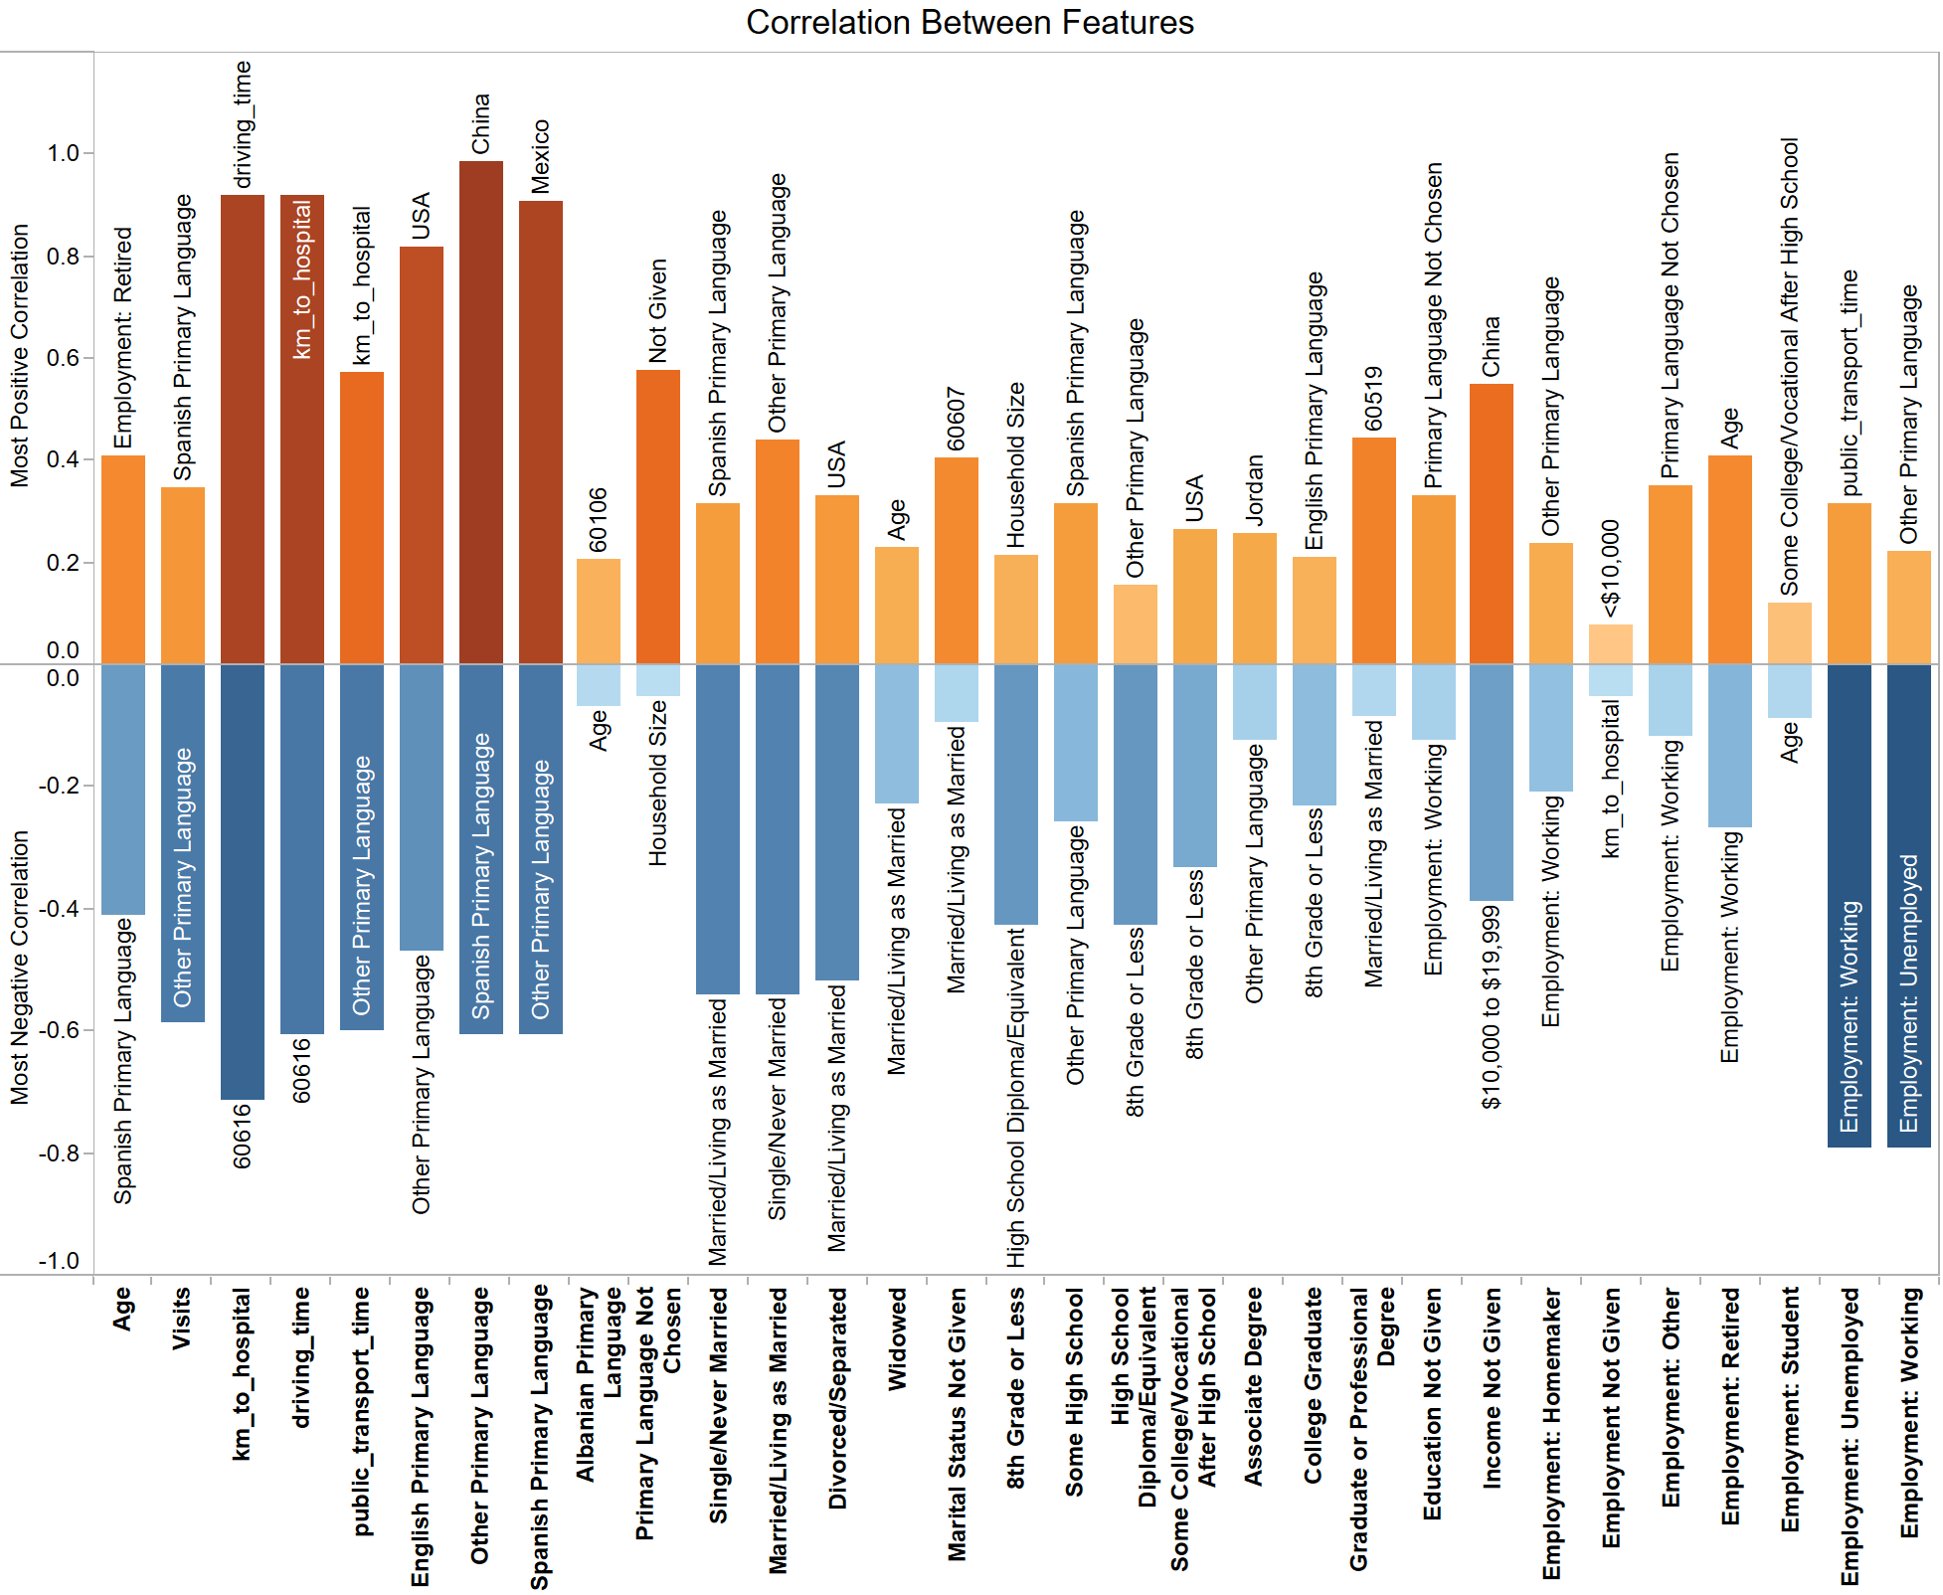

Slide 25
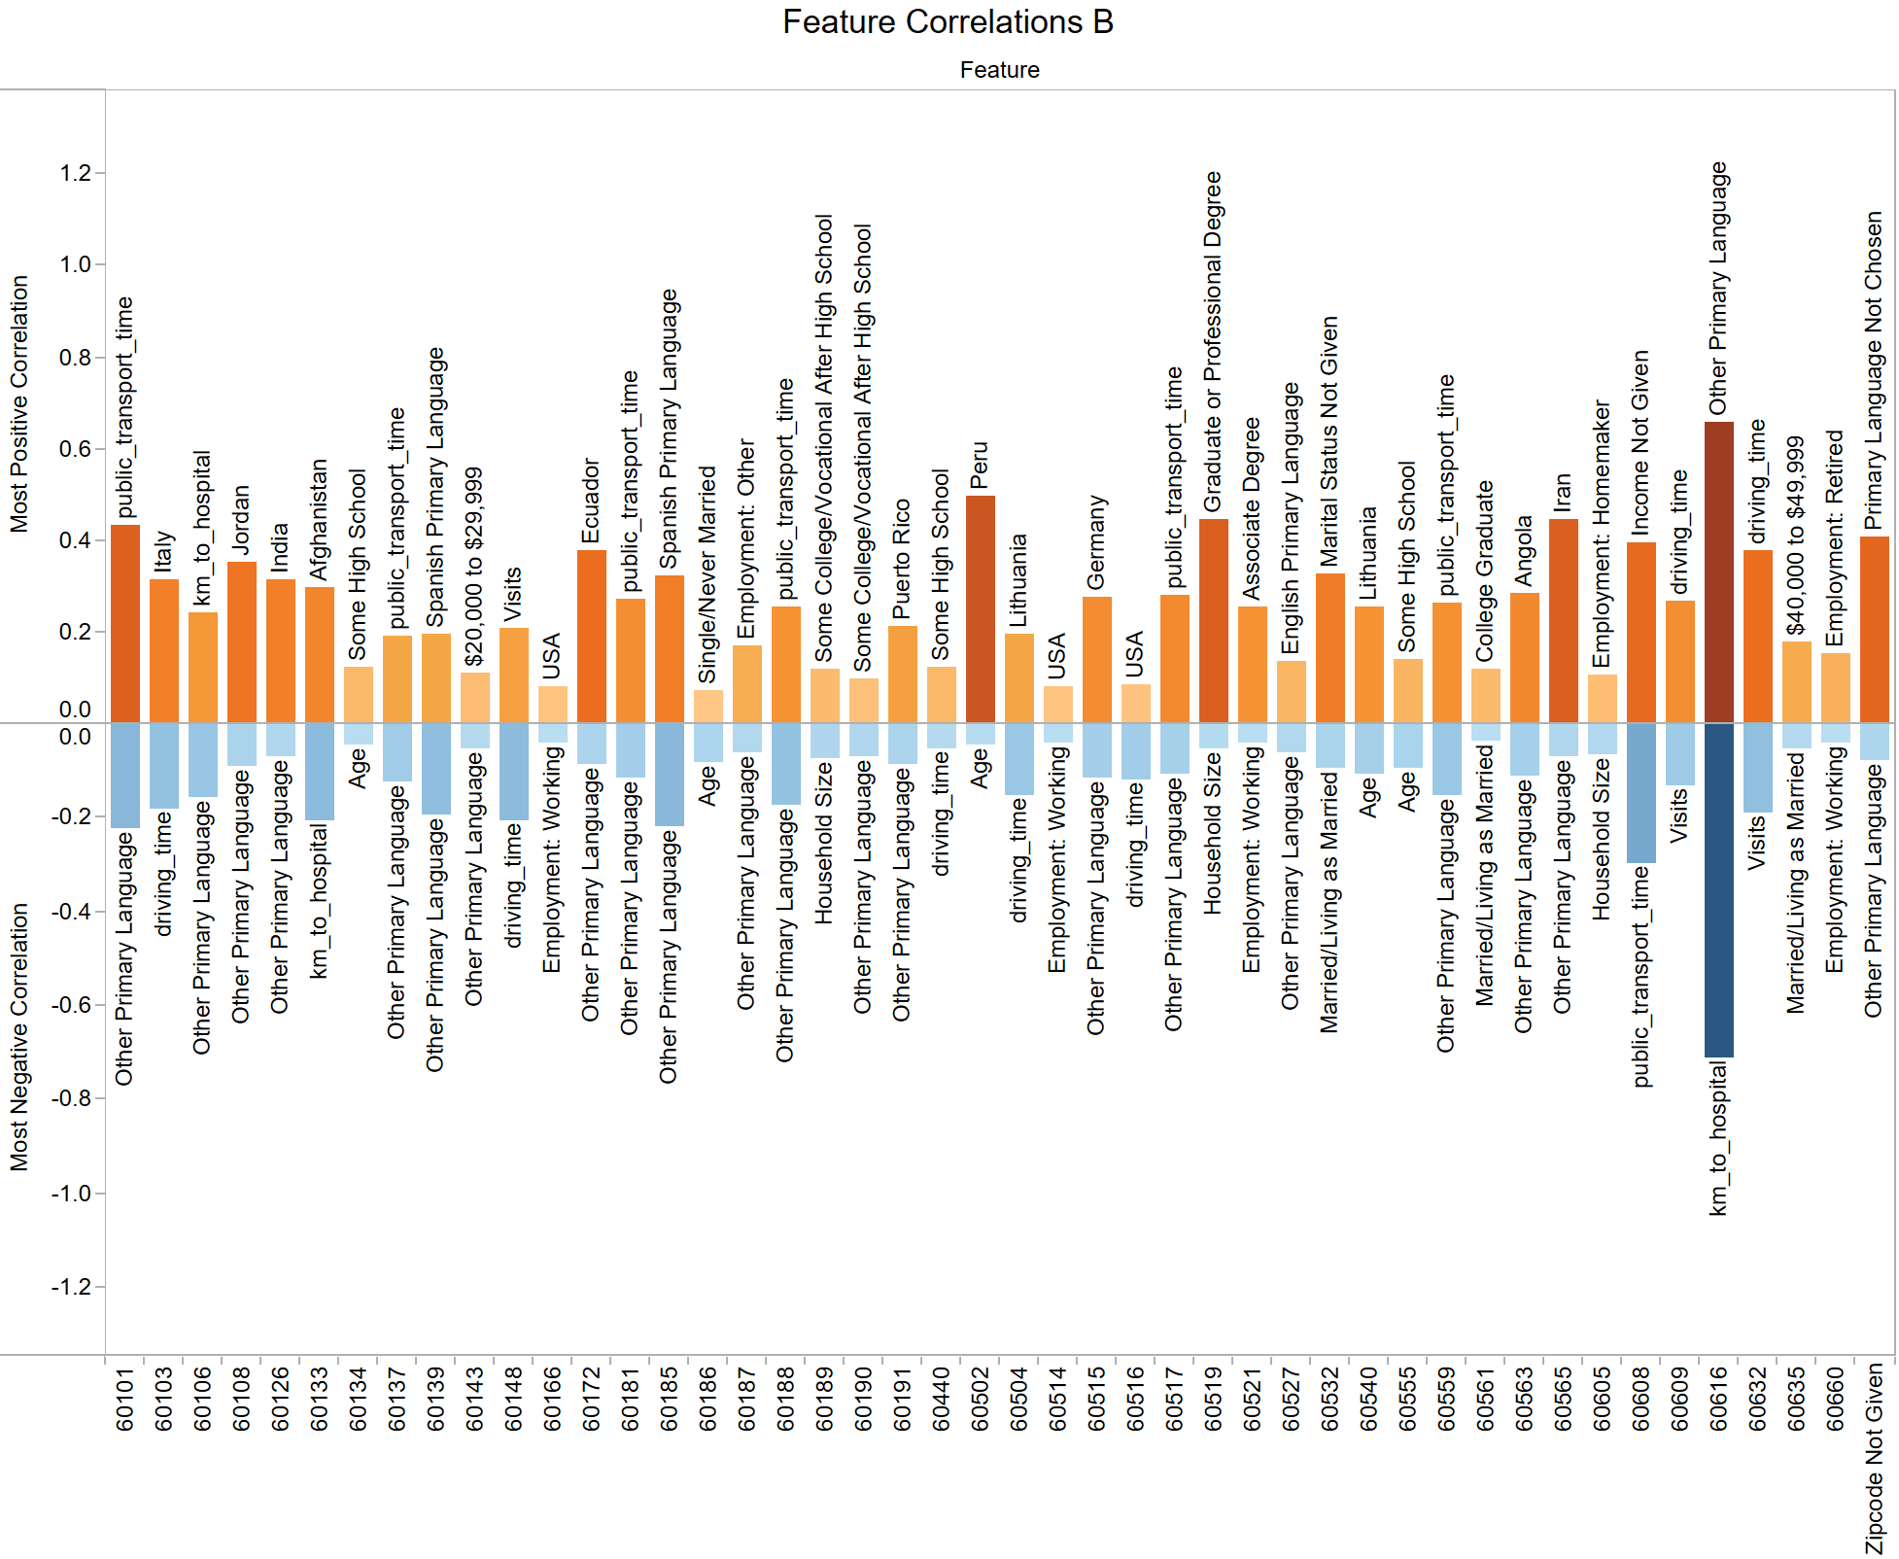

Slide 26
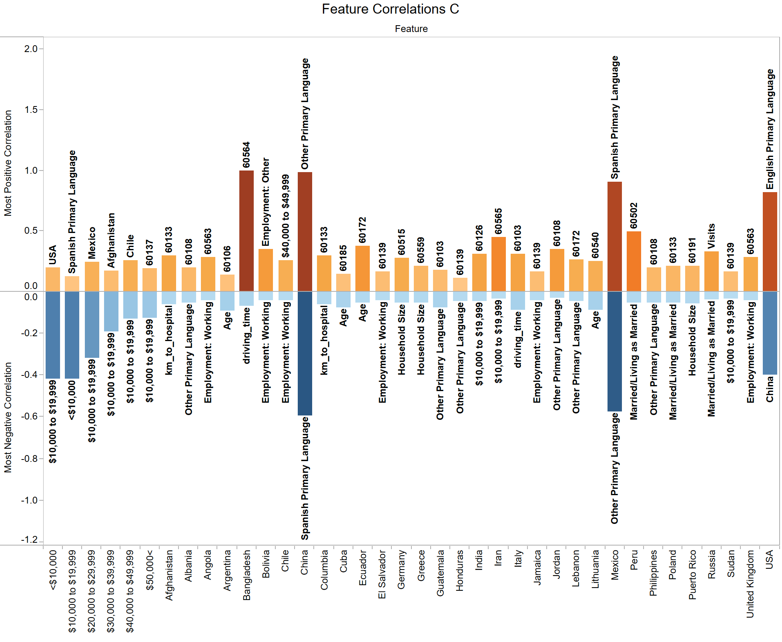

Slide 27
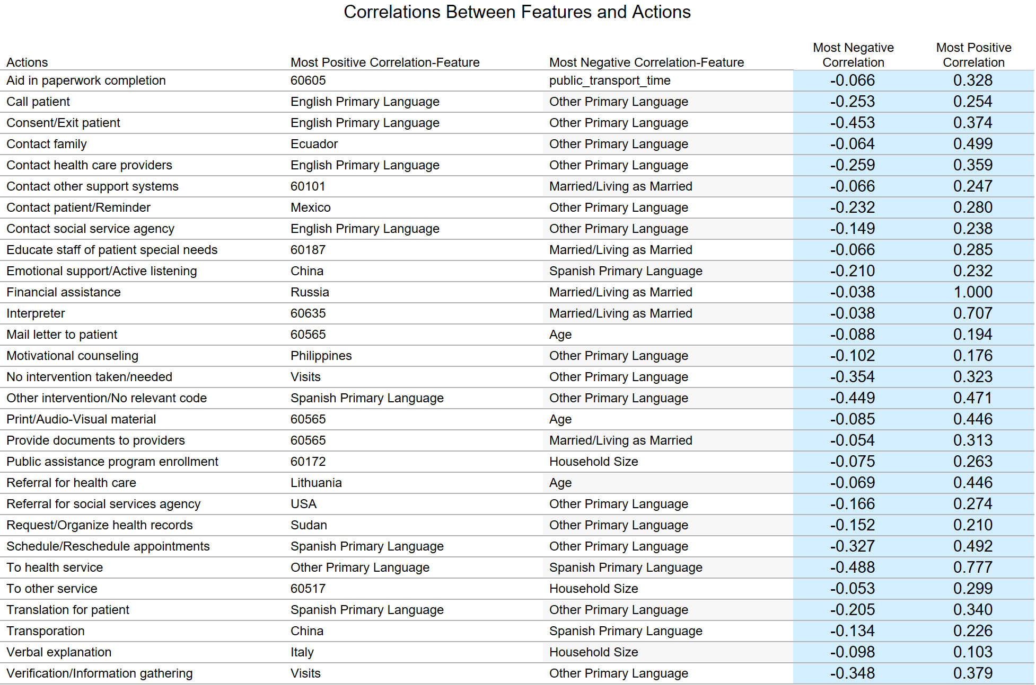

Slide 28
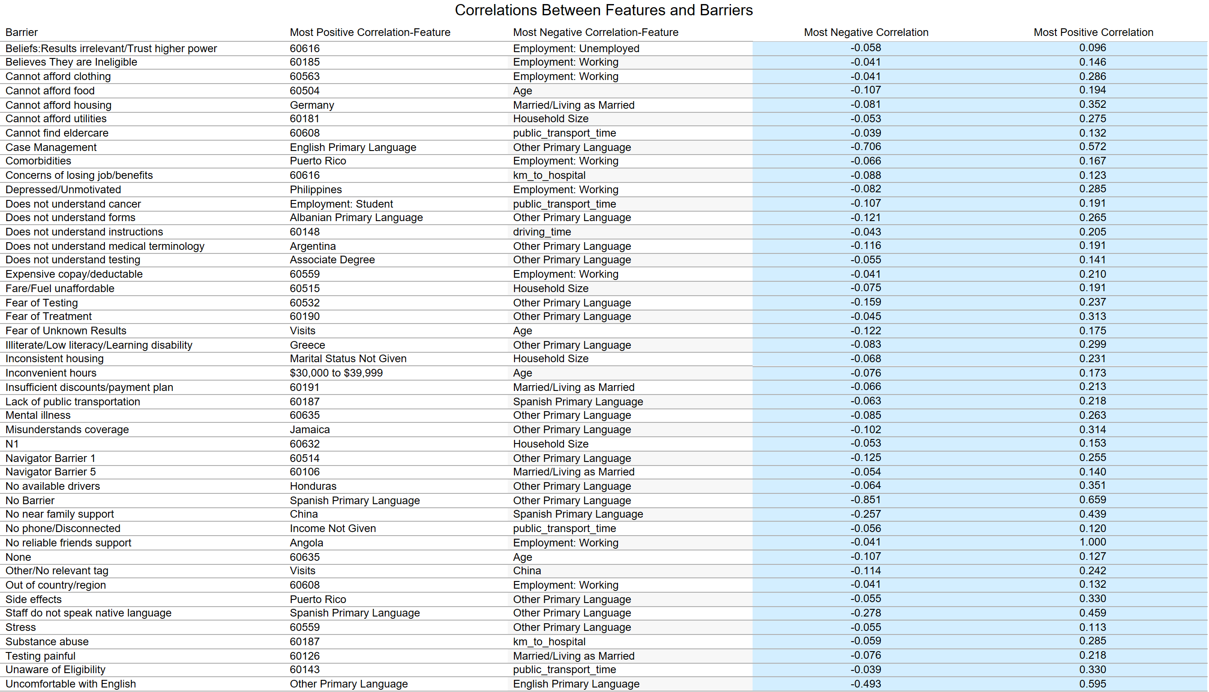

Slide 29
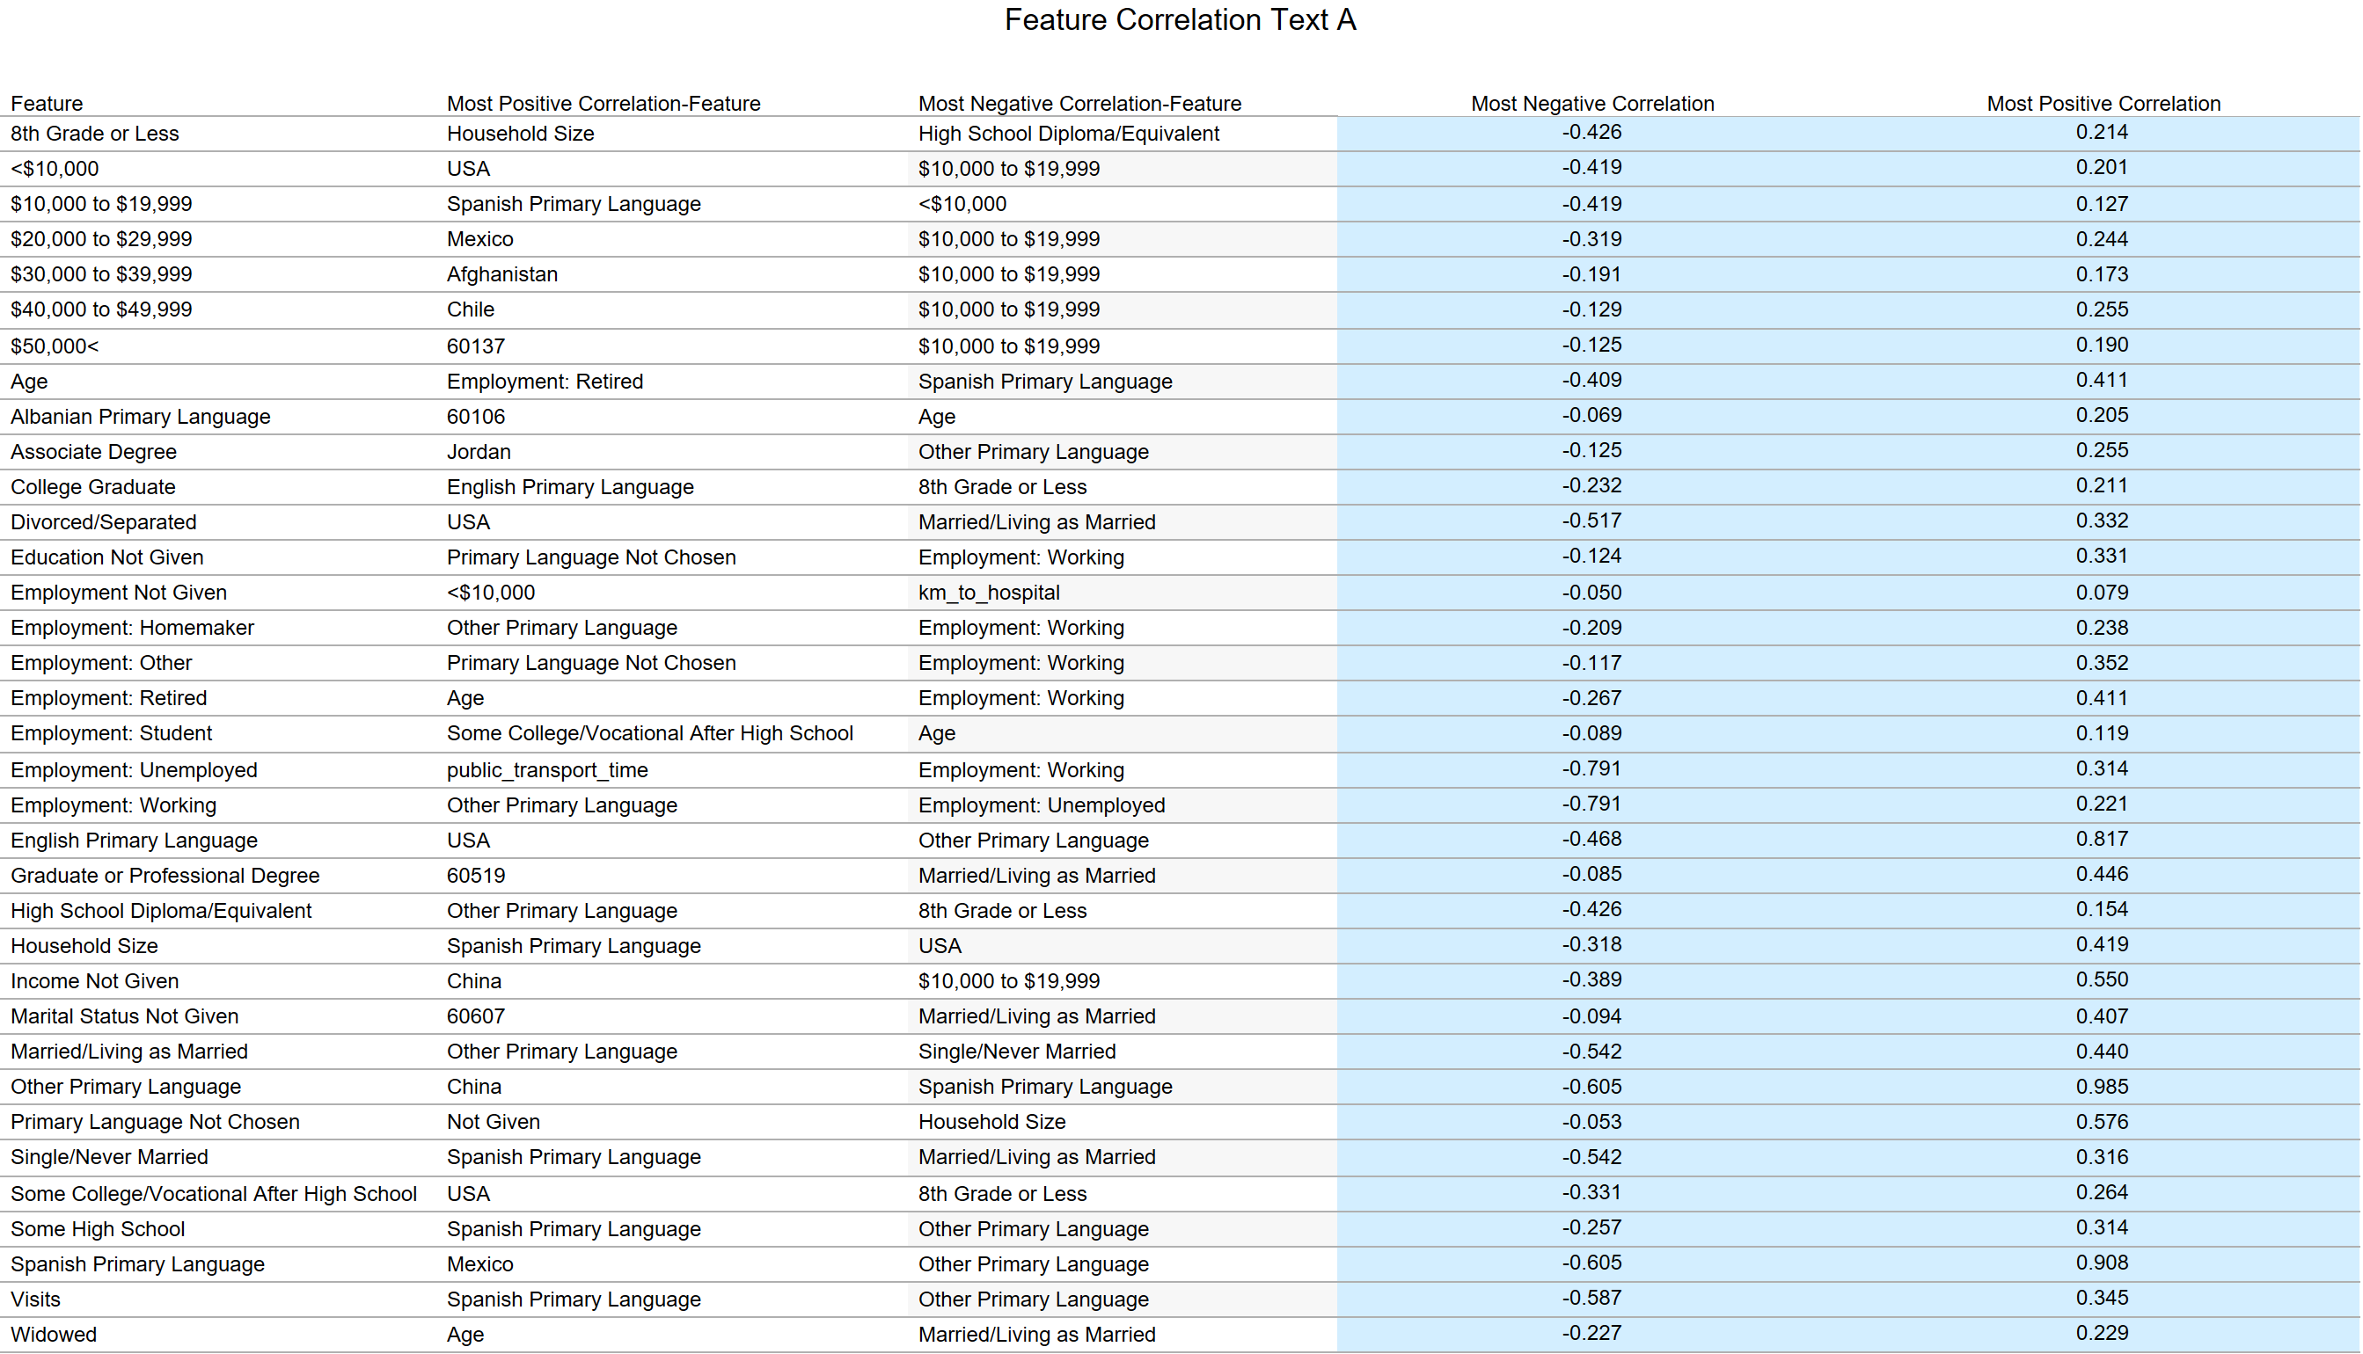

Slide 30
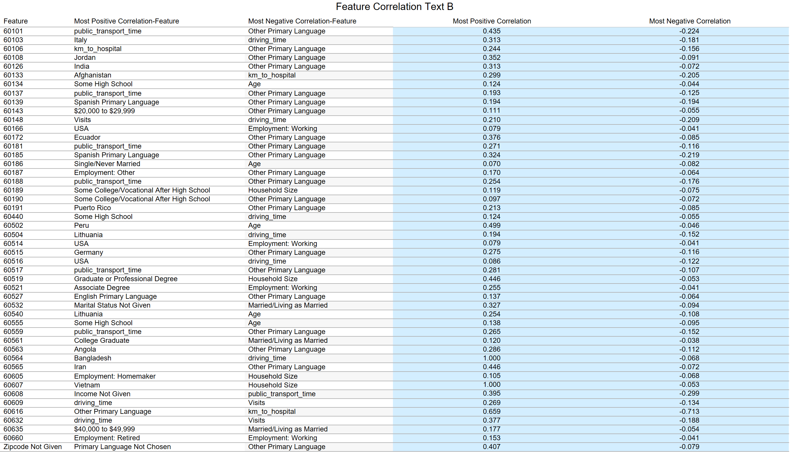

Slide 31
